Slide 1


Abstra
Lazar Milicevic
Weekly support report
Support, Challenges, Sollutions
03.06.2025

Slide 2
Agenda
1. Zendesk Ticket Management & Optimization
3. Reported & Tracked Issues
5. Next Steps
2. Infra & Product Coordination
4. Visual & Helpdesk Improvements
6. Q&A

Slide 3

Zendesk Support & Performance Update
Customer success: Weekly Support Report – 03.06.2025
What was done:
🔁 Agent Licenses & Access: Agent licenses assigned to Greg Dayet and Anastasia Lieva (upgrade from Light Agent).
Requested access to AWS to prepare cloud migration for reporting scripts.📊
⚙️ Automation:
Python script created to automate daily Zendesk signup reports.
Preparing for deployment via AWS Lambda or Okta Workflows.
Script supports:
Tag-based filtering (owkin_k_support)
Auto-categorization (approved, rejected, waitlist)
ID-to-email conversion
Excel export with summary tab
👋 Onboarding & Internal Coordination:
Initiated onboarding for Ewa Kondratowicz:
Personalized Notion onboarding hub created with product process documentation (Owkin K User Guide)
Welcome email with all links and context for 1:1 onboarding session held (May 12, 3–4 PM):
Presented Zendesk setup, processes, and toolsTook ownership of her onboarding:Requested creation of Owkin email address, Coordinating full access setup, Will guide her through all future steps

Slide 4
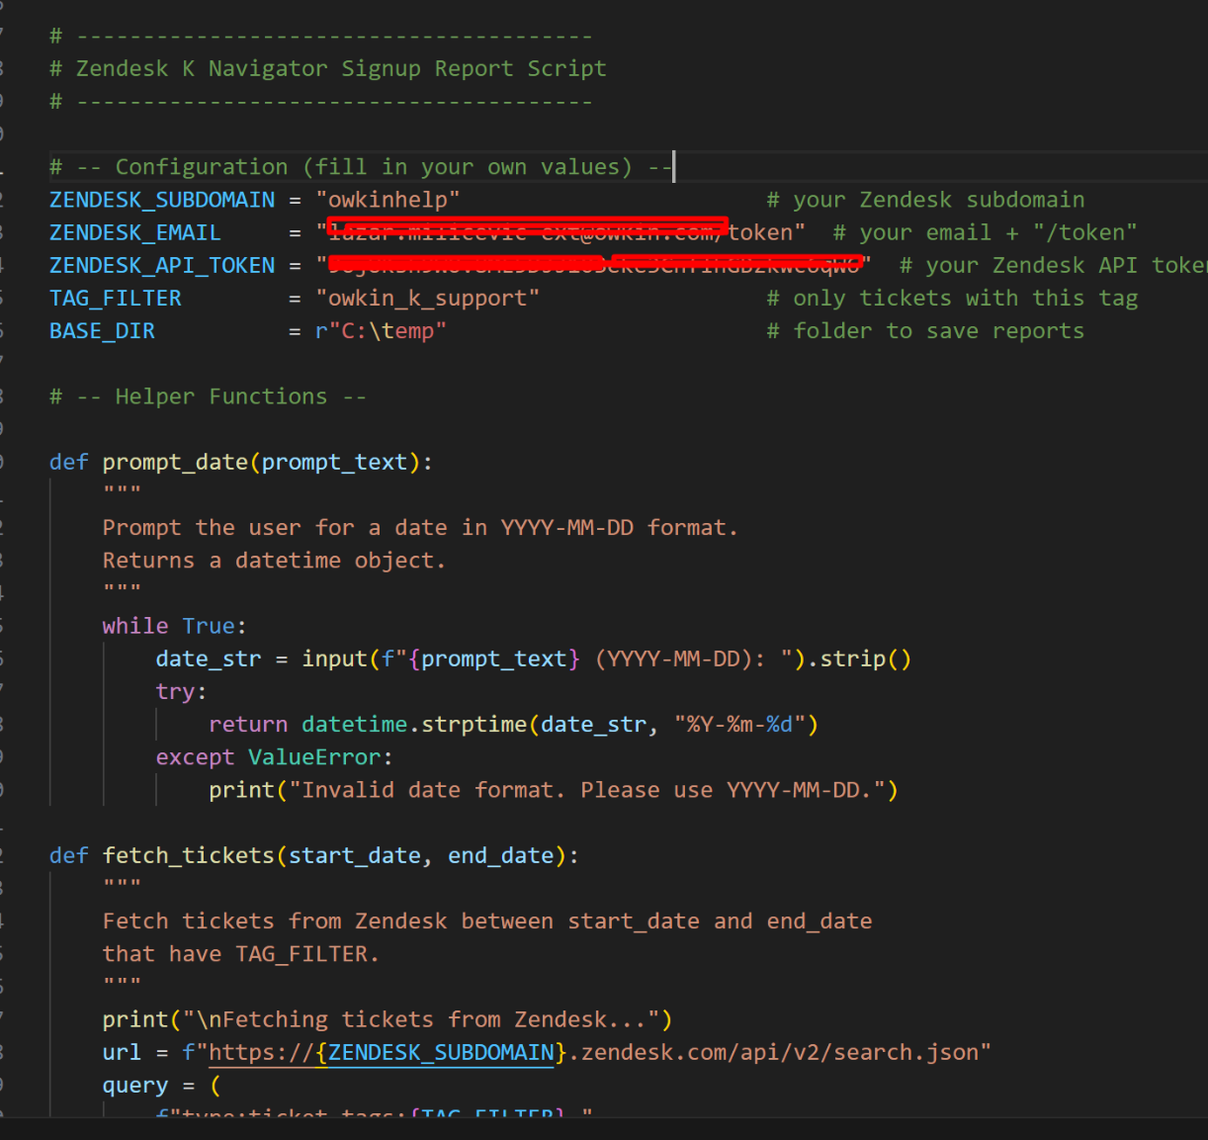
Zendesk – Automated Report for Owkin K Signups
Customer success: Weekly Support Report – 03.06.2025
Where we are now ?
✅ New script developed for automatic daily reporting of Zendesk tickets tagged owkin_k_support.
Script Features:
Pulls tickets by tag & time range
Categorizes by subject + status:
  Welcome = Approved
  Update = Rejected
  Open = Waitlist
Maps requester_id to email
Calculates avg. resolution time
Generates Excel file with:
  Tickets tab (raw data)
  Summary tab (aggregates)
Enables transparent and scalable monitoring of support trends related to K-Navigator onboarding.
Continued improvement of the automated daily signup reporting script:
Added pagination, UTC time alignment, fallback saving
Output includes summary + detailed Excel sheets
Date input validation and improved error handling

Slide 5
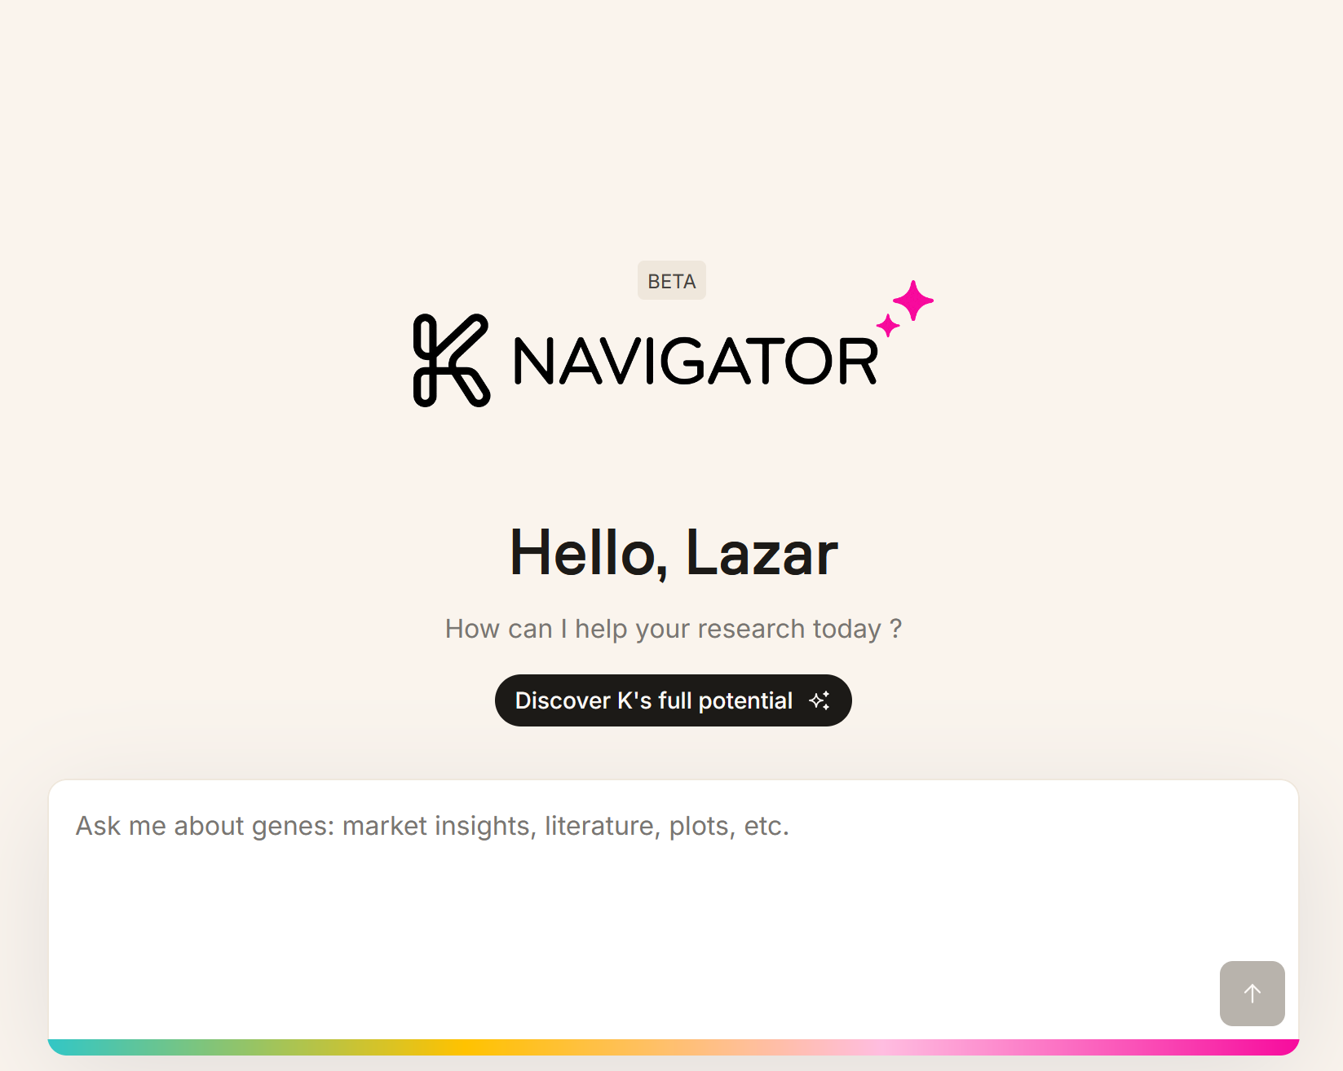
Infra & Product Coordination
Customer success: Weekly Support Report – 03.06.2025
Where we are now ?
Cordinated external user onboarding (CHUV)
After approving account in Cognito, manually notified Owkin K users by email due to lack of automated confirmation.
Supported SurveySparrow survey request
– Provided direct public link to the existing NPS survey
– Confirmed no login is needed
– Verified that responses are consolidated with widget-based submissions
Working on the detecting different Owkin K issues, and reporting them.
Granted AWS Cognito access, currently managing K-Navigator user approvals
Deployed WireGuard VPN access for multiple external users with setup guides
Held 1:1 sessions with Hackathon users to restore access after IP changes
Collaborated with Product, AI, and IT teams on onboarding flow improvements and permission coordination

Slide 6
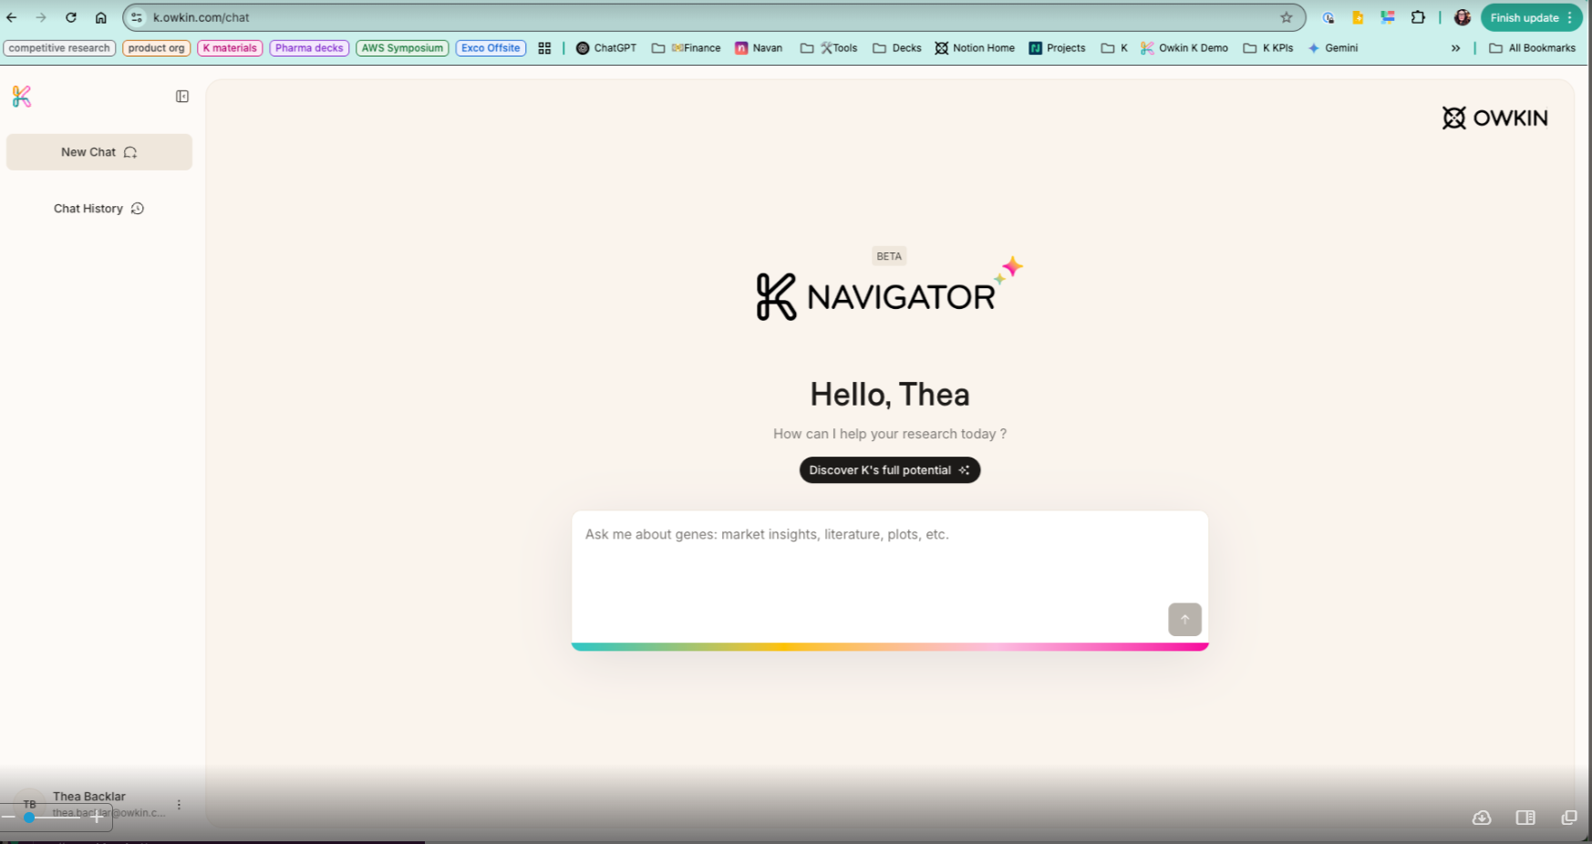
Reported & Tracked Issues
Customer success: Weekly Support Report – 03.06.2025
Some of them:
🔍 Investigated issue: Feedback widget not showing if cookies are rejected on first login.
Proposed fallback: always display button → redirect to SurveySparrow if cookies blocked.
Fix successfully implemented by Jeremy.
Linear ticket [K-806] updated and Slack summary shared.

Slide 7

Visual & Helpdesk
Customer success: Weekly Support Report – 03.06.2025
✅ 3 Zendesk onboarding sessions completed
– Presented Zendesk features, support process, and internal tools
✅ Created Zendesk view for Owkin K signups tracking
– To support easier Cognito approvals
✅ Validated dataset access for Hackathon participants
– Confirmed access in Abstra for all three teams
✅ Supported and follow-up on additional datasets which they required.
💡 PostHog evaluation:
Tool researched as unified solution to replace FullStory, SurveySparrow & GA.
Feature analysis included:
  Session tracking, heatmaps, feedback, A/B testing, cookieless analytics.
Improvements & Tooling:
Completed onboarding for new CSE team member – Notion hub with all resources and walkthroughs
👉 Ewa Kondratowicz – CSE Onboarding
Standardized templates and onboarding documents for future hires

Slide 8
Next Steps
Customer success: Weekly Support Report – 03.06.2025
?
☁️ Migrate Zendesk report script to AWS/Okta for automated daily delivery.
✅ Ewa’s access setup.
🤝 Guide Ewa through full onboarding journeys.
📊 Track impact of fallback widget logic in FullStory sessions.
📥 Continue daily exports of signup ticket reports to Google Drive.
Regular support for K-Navigator users, inproving processes.

Slide 9

Q&A
Customer success: Weekly Support Report – 03.06.2025
?

Slide 10
Thank you!

